Slide 1
AWS DeepRacer
Object Avoidance
Jason Caldwell

Slide 2
Executive Summary
23 models were trained from 15 minutes to 3 hours
Some were also cloned from earlier versions
4 models passed evaluation (3 laps without crashing)
2 in time trials
2 in object avoidance with 2 fixed objects
Only 29% of project’s budget was used

Slide 3
AWS DeepRacer
System to explore reinforcement learning and to build autonomous driving applications.
Consists of:
AWS DeepRacer Console
AWS DeepRacer Vehicle
AWS DeepRacer League

Slide 4
AWS DeepRacer Console
Graphical user interface.
Train a reinforcement learning model with a specified reward function, optimization algorithm, environment, and hyperparameters.
Choose a simulated track to train and evaluate a model by using SageMaker and AWS RoboMaker.
Clone a trained model to optimize your model's performance.

Slide 5
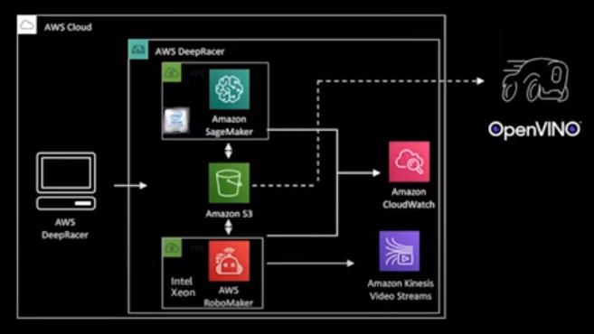
AWS DeepRacer Architecture
SageMaker
S3
RoboMaker
CloudWatch

Slide 6
Tracks
AWS Summit Raceway
provides a solid training warm up.
Oval Track
good choice for getting started.
re:Invent 2018 Wide
use it to get started with object avoidance.

Slide 7
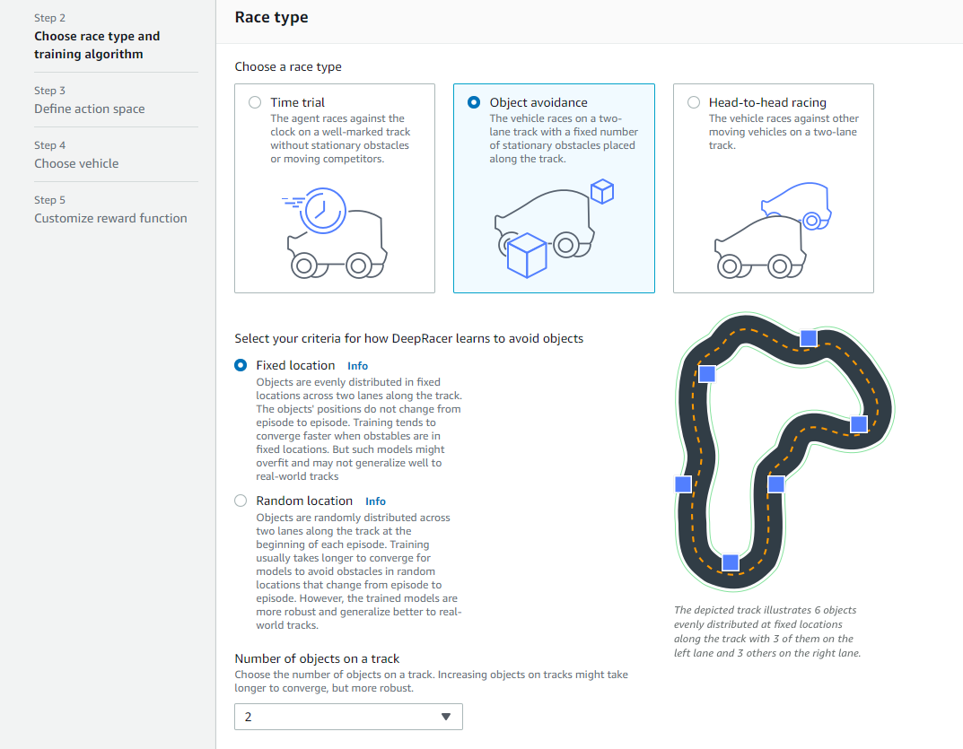
Race Types
Time trial
Object avoidance

Slide 8
Hyperparameters
Gradient descent batch size: 64
Entropy: 0.01
Discount factor: 0.5
Loss type: Huber
Learning rate: 0.0003
Number of experience episodes between each policy-updating iteration: 20
Number of epochs: 10

Slide 9
Vehicle Sensors
Images are converted into greyscale.
Camera
lowest cost sensor solution
Stereo camera
can generate depth information of objects on track
LIDAR sensor
light detection and ranging sensor
continuous visibility

Slide 10
Reward Functions
Lambda functions written in Python
Used several to train the different models
The best performing model combined multiple examples

Slide 11
Input Parameters
all_wheels_on_track
closest_objects
distance_from_center
heading
is_left_of_center
is_reversed
objects_location
objects_left_of_center
progress
steering_angle
track_width
waypoints
x
y

Slide 12
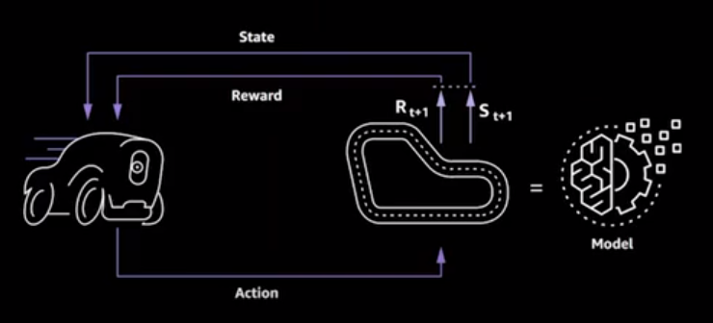
Reinforcement Learning Process

Slide 13
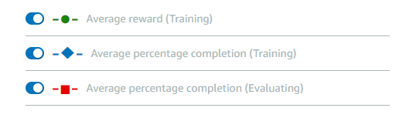
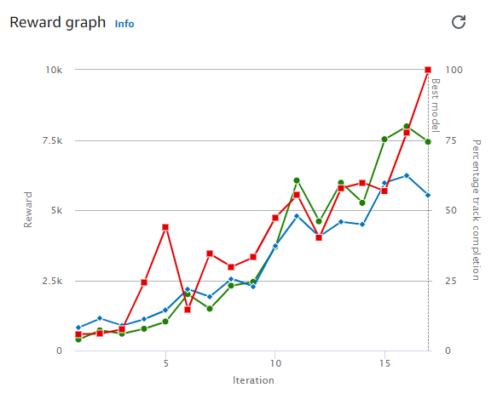
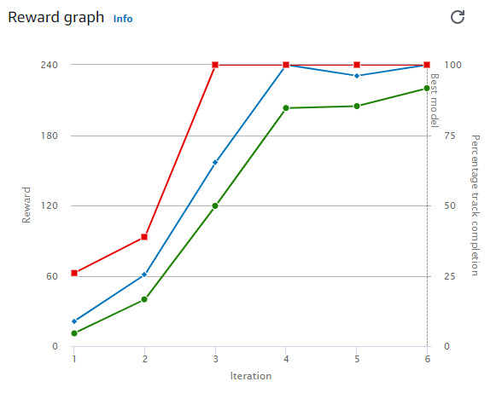
Positive Training

Slide 14
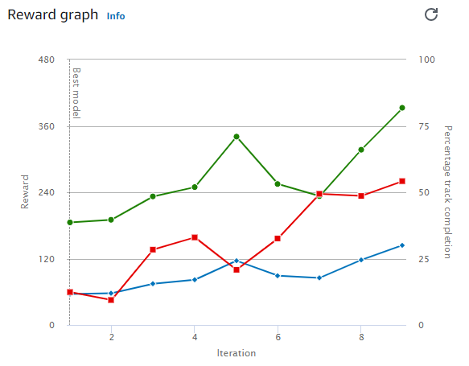
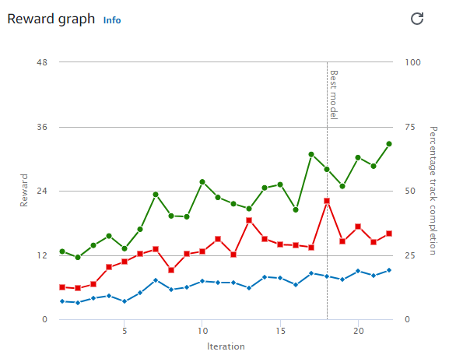
Slower Training

Slide 15
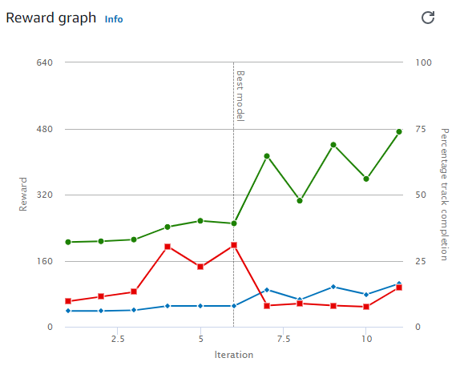
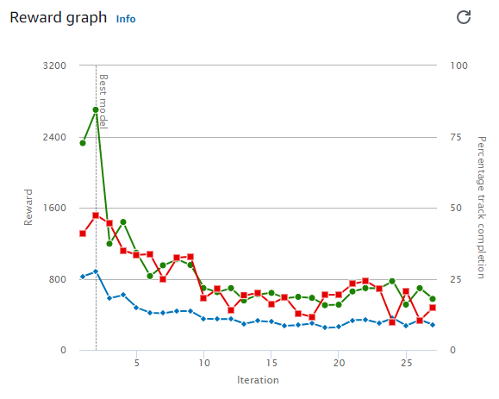
Negative Training

Slide 16
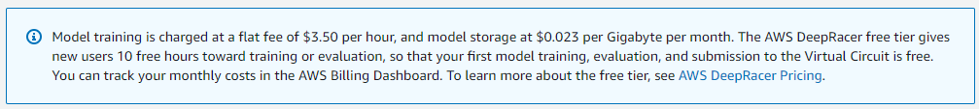
Project’s Budget
$100
Evaluate progress after
Free trial had expired
Every $25
Spent $28.62 total
Some examples online would cost $10k+ to replicate

Slide 17
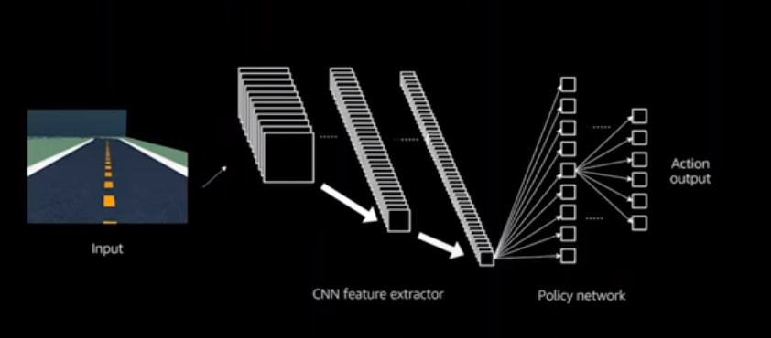
Convolutional Neural Network

Slide 18
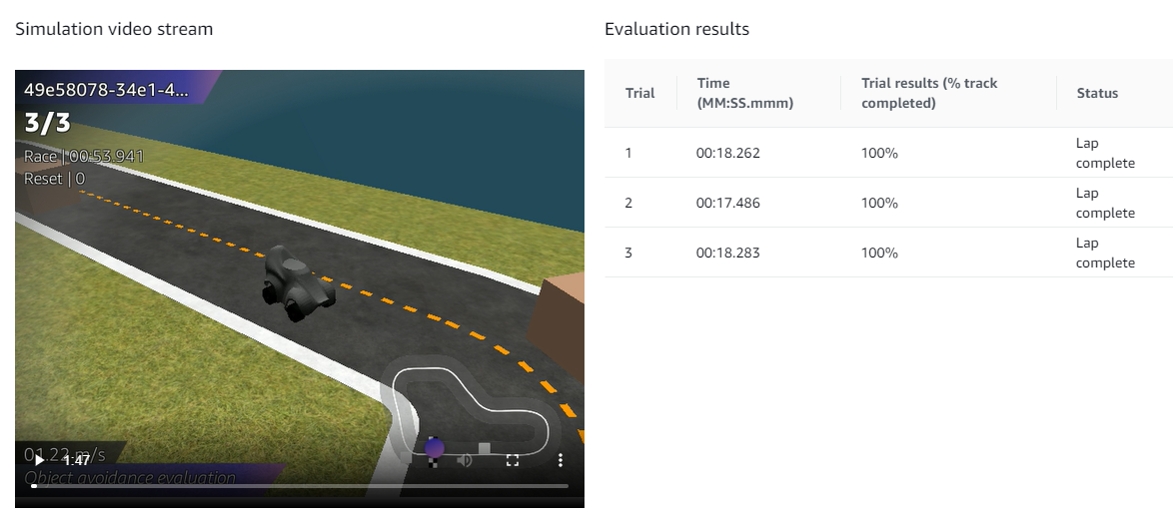
Evaluation
4 models passed evaluation (3 laps without crashing)
Most complicated and best performing

Slide 19
Conclusion
4 models passed evaluation (3 laps without crashing)
2 in time trials
2 in object avoidance with 2 fixed objects
Only 29% of project’s budget was used
Important Setup
Discount factor for hyperparameters
Stereo camera for sensors
Waypoints and objects_location for parameters

Slide 20
Next Steps
Setup environments with lower training costs
Local setup
Using individual AWS services and spot pricing
Create optimal waypoints for left and right lanes
Evaluate more scenarios after longer training times

Slide 21
Questions?
References:
AWS (2021). AWS DeepRacer Developer Guide.
AWS (2021). Input Parameters of the AWS DeepRacer Reward Function.
Kesha Williams (2020). Get rolling with machine learning on AWS DeepRacer.

